Slide 1
Chasing Unicorns at T-Mobile
Chris Hill Senior Manager Developer Platforms, T-Mobile

Slide 2

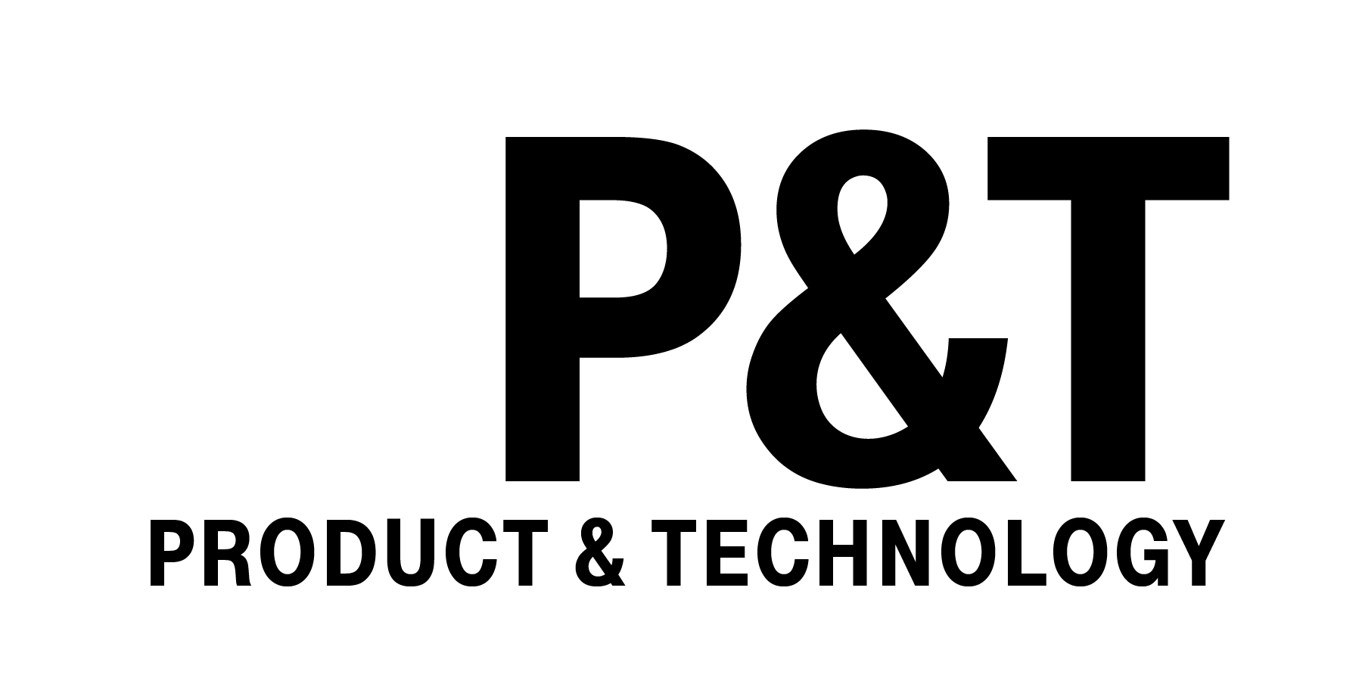
CHASING UNICORNS AT T-MOBILE
Chris Hill: Senior Manager, Software Development
T-Mobile Confidential
6/25/2020
Notes:
Introduction of myself – Chris Hill Senior Manager of Developer Platforms at T-Mobile
Chasing the unicorns from a developer experience perspective.
Highly passionate about and hope it resonates with everyone out there.

Slide 3
Table of contents
01
02
03
04
Why invest in Developer Experience
Transformation Fatigue
Transition out of chaos
Lessons Learned
Notes:
Flow is intended to tell a story about a miserable dev experience
-transition-
T-Mobile investing in developer experience and why
-transition-
Tactical people changes to ground principles
-transition-
Tactical process to show transformation is uncomfortable
-transition-
Tactical Tools to eliminate context switches
-transition-
Recruitment promo

Slide 4
ONBOARDING
Where developers first lose motivation
Notes:
I'm going to start off in an area in which no one seems to like to talk about.
You know when you get IKEA furniture - instruction booklet. little pictures of cartoon version super frustrated -- designers empathize with what you’re going through
“these are the tools you need chart” and a nice inventory count of 100s pieces =
.......well I'm still waiting for the day when I inherit a software projects with reasonable instructions like putting together an IKEA table.
Every software project I’ve joined or inherited as a developer feels like I just stumbled into the 850th step of the IKEA table build cycle, but the instructions are missing and every screw is the wrong size and is completely stripped.
If I could just find someone to walk me through it who’s built it before… or someone to show me the design documents… but instead I'm stuck raising a flurry of access requests, incomplete architecture drawings, and 1000s of people with cooked food wanting to know why the table isn’t built yet.
Finally after scouring the earth I might be able to obtain a hard copy of some documentation that walks me through how to raise tickets to get access to pieces I need to see code and environments.
If I’m lucky, the people in approval chain are in the office this week and I can finally start to look at code. In a larger enterprise there may be up to 5 days SLAs in access requests, so I’m basically sitting on my hands until then.. But then we you do get access to the systems, they are fragmented and are large context switches to utilize and understand the entire tool chain. It's like I need to understand the narratives of all the tooling businesses in order for me to understand why things are done in each area.
Sound familiar? What a way to welcome a new developer into a compa≠ny or a new project in the most demotivational and disenfranchising way. I honestly don’t know why more developers don’t run for the hills. If your motivation started at a 10/10 and you experience this painful onboarding before you ever start looking at code, you're down like a 2. You better hope that code is perfectly written and isn't filled with debt because you don't have much motivation left to work with.
--- Transition --- At T-Mobile, customer experience is in our blood

Slide 5

OUR CUSTOMERS
Notes:
, and just like a better subscriber experience leads to lasting and growing revenue, a better developer experience leads to higher software throughput, higher retention. The more investment you make to keep that motivation up from the beginning, the happier your devs will be.
Why does this make sense? How does developer experience lead to results I can reconcile?

Slide 6
How does the experience lead to results?
Less cognitive load for context switches
Less wait time within your developer value stream
1s saved in every ci/cd job
Empowering rather than impede leads to increased creativity
Assumption: transformation confidence
Notes:
How does the developer experience actually reconcile into results?
Less context switch between value add to product and realization of the value (CI/CD Pipelines, branch workflow).
Conways law
Wait time spent within your developer value stream, In fact for every 1s saved across all of our CI/CD jobs it's like we just hired 1 full-time engineer. 44k jobs per day * 5s / 60s * 261 work days per year = $957,000 per year / 200k = 4.785.
If the wider business does not have confidence in your strategy or your product, you're not going to get priority cycles to be effective. Now let's dive a bit on change

Slide 7
CHANGE
Transformation = Fear of loss
Notes:
Fear of loss because "we've been told this is the last time we're moving". "What I have works for us".
If you're not investing in earning confidence in the value of your shared service – are you doing the best thing for your company?
I've been with T-Mobile driving this initiative for 2 years, and I've asked myself if we were just late in determining how valuable developer experience is?
If we would have started investing earlier, would it have made a difference? I've reconciled the answer in that's its much more complicated than that…
You can't take a unicorn's playbook and become the unicorn overnight. There's a lot of work to make transformation successful - you've got:

Slide 8
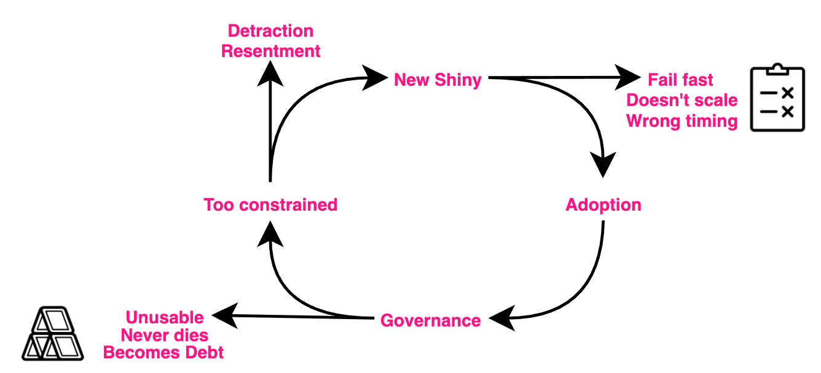

Slide 9
Transformation life cycle
Measuring Cycle – before platform. To platform, after platform.
Include empowerment
Until deprecation

Slide 10
Deliver on platform transformation
People to convince,
Funding to earn,
Legacy systems to keep running and integrated with,
Anti-patterns and behaviors to break,
Architectures to rip apart,
Network firewall rules to change,
Policies to challenge,
Culture to evolve,
Unplanned work to compete with….
Notes:
people to convince,
funding to earn,
legacy systems to keep running and integrated with,
anti-patterns and behaviors to break,
architectures to rip apart,
network firewall rules to change,
policies to challenge,
unplanned work to compete with….
If you have a platform you need to transform which is at 90% unplanned work, the entire team has no room to even have a thought on how this could be better. I went through multiple pairs of headphones due to 10+ hour bridges where the black part of the padded area starting to ware off like I was getting a haircut. We used to be in constant crisis where it was nothing but reaction incident after incident.
We need a new way - John Allspaw's phrase "Incidents are unplanned investments" was our biggest headline, and was our fuel with how to do change this experience.
(culturally relative – CSBR – the culture at the unicorn may not be relevant to a T-Mobile) the model of the other culture has history, legal implications fit with Telecom? Sprint acquisition required a 2 year journey...) SAFE to make it work for T-Mobile.
One of our approaches

Slide 11
Acknowledge poor experience
"This isn't ideal, but this what we're doing today to make it better in the future."
Use the incidents to determine refinement priority.
Notes:
Transformation is intended to be fruitful for all, but it's painful for some and uncomfortable for most. Now that's a different message – we acknowledge this experience isn't ideal, but this is what we're doing to make it better everyday.
What should "this" be? It changes every day in a crisis, but let your post mortems dictate your priority.
This is my 4th industry going through a digital transformation; semiconductors, retail, automotive, and telecom - I keep thinking one day it's going to be easier - but it never is, who am I kidding. Telecom had the same crippling legacy debt smothering our ability to ever improve. It's like your in a hole trying to claw your way out but the bottom is legacy quick sand.
-transition- there is hope for getting out of that hole, here are some things that worked for us.

Slide 12
Turn unplanned to planned
Blameless postmortems for all incidents
Make all work visible
Acknowledgement of debt, preemptively set the stage
Build in discipline
Don't be afraid to backout.
Reward flawless execution.
Notes:
Get out from underneath the your own short-comings
Blameless post mortems became almost an everyday event. One day we had scheduled 3 post mortem reviews, but had to reschedule them due to the current incident right in front of us. During those times our incidents bled into our post mortem meetings.
We asked ourselves the question where does work come from?
How long before the change is completed? How long would it take to roll back to a known state?
I'd much rather have known state than hold my beer this might work.
- transition- to now you can find the right questions

Slide 13







Now you find the right questions
Do you know what "good" looks like?
What are our measurements for success?
Where are our bottlenecks?
What standards should be enforced and what can remain flexible?
Are we impeding or empowering?
Do we have a community of support?
Do our customers believe in us?

Slide 14





Find the right solutions
Define and refine best practices you can control and simultaneously challenge the ones you can't for more refinement. Think unicorn and ideal, but also iterations.
Determine large scale directional movements in people process and tools.
Treat feedback like gold - accommodate for what makes an amazing developer experience. We measure NPS.
Move to low-context switch, low cognitive load, throughput focused tools like GitLab and Gitlab-CI
Core Vs. Context
Notes:
Gitlab and Gitlab-CI are source control and Continuous Integration in one. Interface, narrative, login, experience are all the same?
The last point I want to make in regards to technology is the shift from working on core vs context.

Slide 15

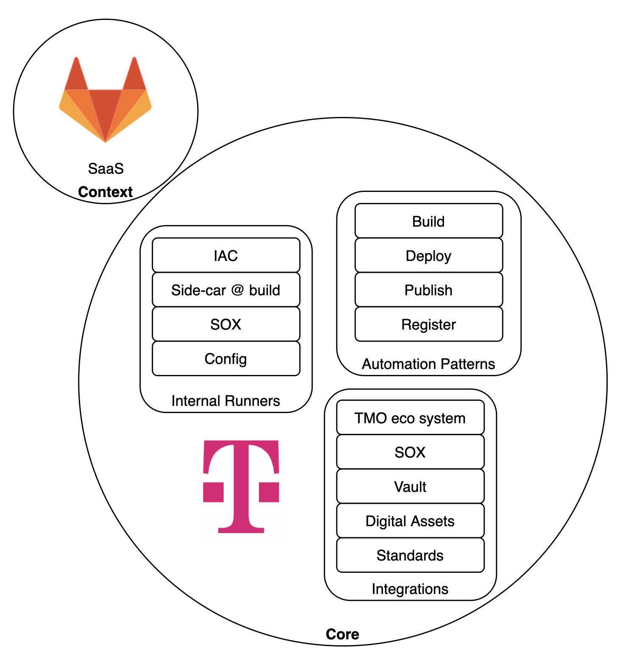
CORE VS CONTEXT

Slide 16



Lessons Learned
Is this the best thing for your team or for the enterprise?
Transformation fatigue is a thing.
Focus on the what constraints cannot move and which ones can.
Obtain adoption inertia by unlocking the passion.
Notes:
Failed transformations could lead to extremely productive 2nd attempt.
I'm notorious for testing this boundaries – are you sure we can't just do this? Ok, How about this instead? Usually after the 2nd or 3rd no, you've determined you will need to channel your inner
Eliyahu Goldratt to subordinate the constraint another way. Most of the time there are other levers to pull.
As you're introducing someone to transformation, you should be unlocking their passion and turn them into raving fans.

Slide 17

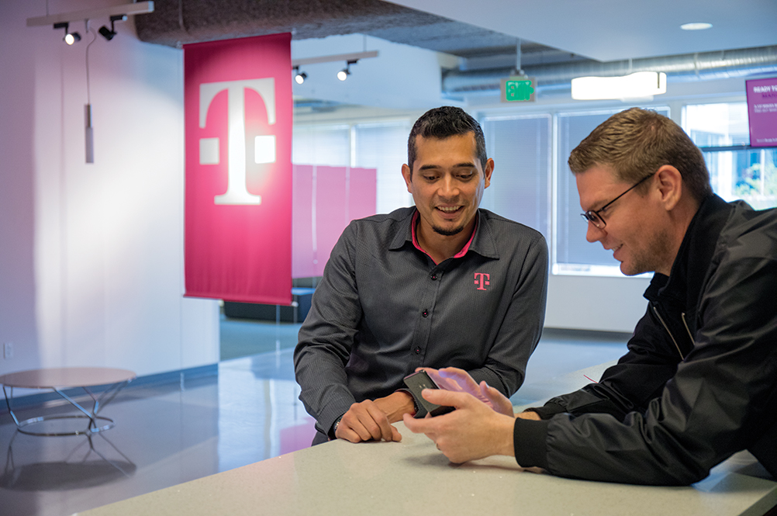



Welcome, Sprint.
Welcome, opportunity.
With Sprint joining the T-Mobile family, there are even more ways to grow your career. Transform an industry with us!
https://www.t-mobile.com/careers

Slide 18
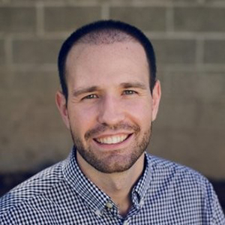
Thanks for listening
Chris Hill
Senior Manager
Developer Platforms
T-Mobile
LinkedIn.com/in/ChrisHillPDX

